Slide 1
CODE REVIEW

Slide 2
What is Code Coverage?
Code Coverage testing is determining how much code is being tested.
Term used in software testing to describe how much program source code is covered by a testing plan
It can be calculated using the formula:
Code Coverage = (Number of lines of code exercised)/(Total Number of lines of code) * 100%

Slide 3
Developers look at the number of program subroutines and lines of code that are covered by a set of testing resources and techniques.
Using code coverage analysis, development teams can provide reassurance that their programs have been broadly tested for bugs and should be relatively error-free.

Slide 4
What is Code Freeze?
Code Freeze means the code is frozen and there will not be any further modifications from the developers.
After the code freeze, the code should not be changed by the developers.
Only in case of critical defects, developers change the code after the approval of the change control board and make the changes required to fix that critical defect.
Code freeze will happen only in the final stages of the software development.
Post Code freeze, the build is deployed to production environment.

Slide 5
What is code Inspection?
Code Inspection is the most formal type of review, which is a kind of static testing to avoid the defect multiplication at a later stage.
The main purpose of code inspection is to find defects and it can also spot any process improvement if any.
An inspection report lists the findings, which include metrics that can be used to aid improvements to the process as well as correcting defects in the document under review.

Slide 6
Preparation before the meeting is essential, which includes reading of any source documents to ensure consistency.
Inspections are often led by a trained moderator, who is not the author of the code.
The inspection process is the most formal type of review based on rules and checklists and makes use of entry and exit criteria.
It usually involves peer examination of the code and each one has a defined set of roles.

Slide 7
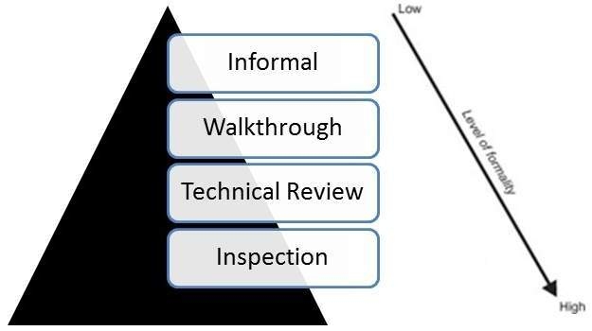
Where Code Inspection fits in ?

Slide 8
What is code review?
Code Review is a systematic examination, which can find and remove the vulnerabilities in the code such as memory leaks and buffer overflows.
Technical reviews are well documented and use a well-defined defect detection process that includes peers and technical experts.
It is ideally led by a trained moderator, who is NOT the author.

Slide 9
This kind of review is usually performed as a peer review without management participation.
Reviewers prepare for the review meeting and prepare a review report with a list of findings.
Technical reviews may be quite informal or very formal and can have a number of purposes but not limited to discussion, decision making, evaluation of alternatives, finding defects and solving technical problems.

Slide 10
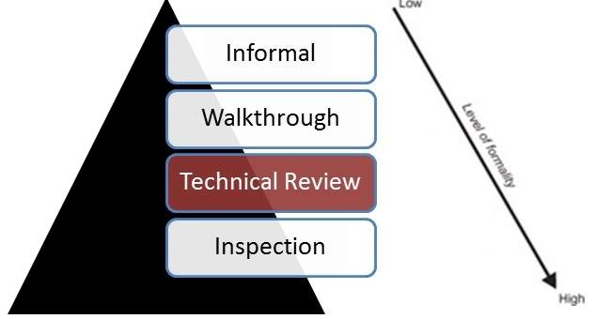
Where Code Review fits in ?

Slide 11
What is Code Walkthrough?
Code Walkthrough is a form of peer review in which a programmer leads the review process and the other team members ask questions and spot possible errors against development standards and other issues.
The meeting is usually led by the author of the document under review and attended by other members of the team.
Review sessions may be formal or informal.

Slide 12
Before the walkthrough meeting, the preparation by reviewers and then a review report with a list of findings.
The scribe, who is not the author, marks the minutes of meeting and note down all the defects/issues so that it can be tracked to closure.
The main purpose of walkthrough is to enable learning about the content of the document under review to help team members gain an understanding of the content of the document and also to find defects.

Slide 13
What is Security Code Review?
Is the process of auditing the source code for an application to verify
that the proper security controls are present,
that they work as intended, and
that they have been used in all the right places.
Code review is a way of ensuring that the application has been developed so as to be “self-defending” in its given environment.

Slide 14
All security code reviews are a combination of human effort and technology support.
At one end of the spectrum is an inexperienced person with a text editor.
At the other end of the scale is a security expert with an advanced static analysis tool.
Unfortunately, it takes a fairly serious level of expertise to use the current application security tools effectively.

Slide 15
Objectives of Code Review
1. Identify erroneous/wrong code
2. Identify unauthorized code
3. Identify ineffective/useless code
4. Identify unproductive code
5. Identify nonstandard code

Slide 16
Where Do Program Defects Occur?
Tentative Conclusions a small number of program modules will have a large number of faults
Requirement specifications and design errors are as prominent as coding errors
Design errors relate to interface problems with users

Slide 17
Types of review processes
There are many variations of code review processes, some of which are detailed below.
1. Formal inspection
involves a careful and detailed execution with multiple participants and multiple phases.
Formal code reviews are the traditional method of review, in which software developers attend a series of meetings and review code line by line, usually using printed copies of the material.
Formal inspections are extremely thorough and have been proven effective at finding defects in the code under review

Slide 18
An important byproduct of a properly conducted formal code review is a written record describing:
Who: Names of those involved in the Review.
When: Date and time the Review was conducted.
Why: Best-Practice, Error Detection, Vulnerability Exposure, Malware Discovery or a combination.
What: Name of the class, method, or program, plus line ranges and other particulars specific to the reviewed code.
Result: What was disclosed during the course of the Review.

Slide 19
2. Regular change-based code review
Its main characteristic is that the scope of each review is based on the changes to the codebase performed in a ticket, user story, commit, or some other unit of work. ...
Such a review process is called "regular, change-based code review".
There are many variations of this basic process

Slide 20
To perform change-based reviews smoothly, authors and reviewers use software tools:
informal ones such as pastebins and IRC,
or specialized tools designed for peer code review such as Gerrit and GitHub's pull requests.
3. Over-the-shoulder: one developer looks over the author's shoulder as the latter walks through the code.
4. Email pass-around: source code management system emails code to reviewers automatically after checkin is made.

Slide 21
5. Walkthroughs, usually with an emphasis on the presentation and discussion of the code in a meeting.
6. Pair programming, i.e., two authors that develop code together at the same workstation, is very similar to code review but not a code review in the narrow sense.

Slide 22
Code Review Preparation
In order to effectively review a code baseline, it is critical that the review team understands the business purpose of the application and the most critical business impacts.
This will guide them in their search for serious vulnerabilities.
The team should also identify the different threat agents, their motivation, and how they could potentially attack the application.

Slide 23
Before you start, the reviewers should be familiar with:
1. Code: The language(s) used, the features and issues of that language from a security perspective.
The issues one needs to look out for and best practices from a security and performance perspective.
2. Context: The working of the application being reviewed.
All security is in context of what we are trying to secure.
What type of data is being manipulated or processed, and what would the damage to the company be if this data was compromised?

Slide 24
3. Audience: The intended users of the application. Is it externally facing or internal to “trusted” users? Does this application talk to other entities (machines/services)? Do humans use this application?
4. Importance: The size of the consequences of failure. Shall the enterprise be affected in any great way if the application can not perform its functions as intended?

Slide 25
Challenges of code review
1. Time Constraints: Code reviews can be time-consuming, especially for large and complex code changes. Developers and reviewers may have tight deadlines, making it challenging to allocate sufficient time for a thorough review.
2. Resource Allocation: Finding qualified reviewers and coordinating their schedules can be difficult. In smaller teams, there might be limited expertise available for reviewing certain code areas.
3. Reviewer Bias: Reviewers may inadvertently introduce their personal biases into the review process. This can include coding style preferences or preconceived notions about the code's functionality.

Slide 26
4. Overwhelming Feedback: Providing too much feedback on a single code change can overwhelm the author. It's essential to strike a balance between pointing out issues and providing constructive feedback.
5. Resistance to Feedback: Developers may sometimes resist feedback, especially if they've invested a significant amount of time in their code. This resistance can hinder the learning and improvement process.
5. Code Complexity: Highly complex code can be challenging to review effectively. It may require a deep understanding of the underlying algorithms and data structures.

